Slide 1
Introduction to Java
School of Computer Engineering and technology

Slide 2
Module 1 - Overview
Why Java?
Java Infrastructure
Basic Programming Constructs in Java
OO Concepts
OOP in Java
25/07/2019
Introduction to Java
<number>
Notes:
<number>
MIT-WPU

Slide 3
Why Java? (slightly covered)
Closer to English-like syntax than C++
Platform-independent (Platform = Architecture + OS) => hence, WORA
Fully object-oriented
Extensive set of pre-built functionality, available as packages
Sophisticated built-in exception handling mechanism
with verbose error reporting
Secure ----- why? (let’s see in a bit)
Easy to learn for application developers
25/07/2019
Introduction to Java
<number>
Notes:
<number>
MIT-WPU

Slide 4
Java Infrastructure (not covered)
Java Virtual Machine (JVM)
Here comes security!
Java Runtime Environment (JRE)
Java Development Kit (JDK)
Is java compiled or interpreted?
25/07/2019
Introduction to Java
<number>
Notes:
<number>
MIT-WPU

Slide 5
Basic Programming Constructs (covered all)
Background :
All basic provisions of Java are implemented in the java.lang package
String is a datatype in Java (implemented as a Class)
E.g. String myname = “Rahul”;
Java is case-sensitive and follows camelCasing –
Class names start with an uppercase letter
variables, objects and methods start with a lowercase letter
GOOD NEWS : Java does NOT have pointers!!
Caveat: It has “reference variables”
25/07/2019
Introduction to Java
<number>

Slide 6
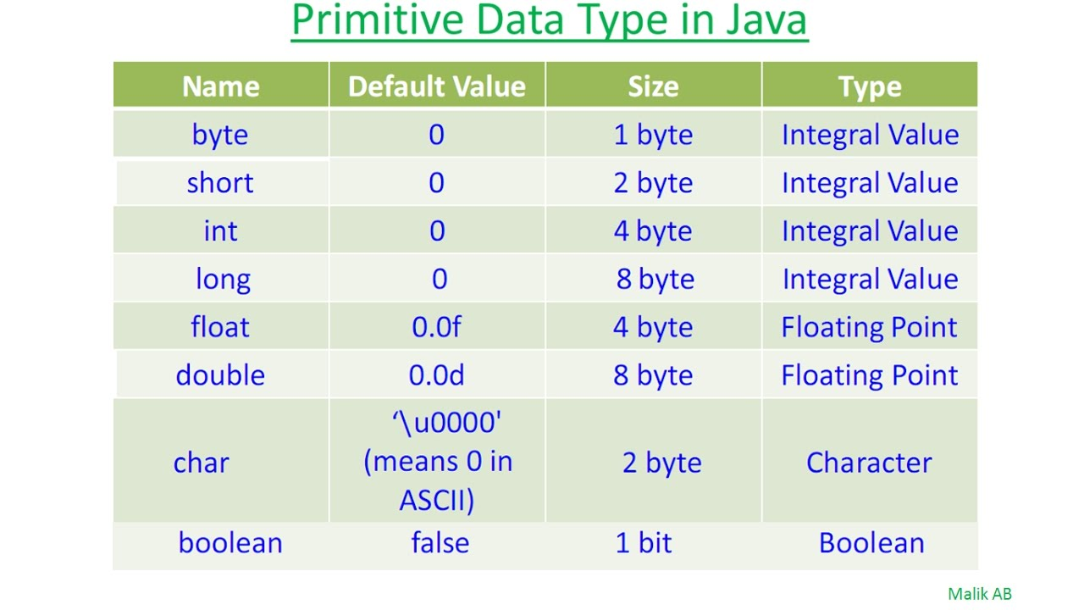
Default values of datatypes (sort of covered)
\
25/07/2019
Introduction to Java
<number>

Slide 7
Basic Programming Constructs (fully covered)
If-then-else construct
boolean f = true; int a = 1;
if (f) {
//statement 1
}
else {
//statement 2
}
Same goes for a while / do-while loop in Java
ILLEGAL IN JAVA
if (a) {
//statement 3
}
else {
//statement 4
}
25/07/2019
Introduction to Java
<number>

Slide 8
Basic Programming Constructs (covered)
The switch-case construct
String day = "Tuesday";
switch(day)
{
case "Sunday":
System.out.println("Kal Monday hai");
break;
case "Saturday":
System.out.println("2 din ki chhutti");
break;
default :
System.out.println("Wait for the weekend");
break;
}
Do we need this break?
25/07/2019
Introduction to Java
<number>

Slide 9
Basic Programming Constructs (for-each not covered)
The for-loop in Java is exactly the same as that in C/C++.
The for-each loop:
float arr [] = new float [5];
for (int i = 0; i<5; i++) { //Here i takes the indices of the array
arr[i] = 2*float(i);
}
for (float i : arr) { //Here i takes the values in the array
System.out.println(i);
}
As you can see, array declarations in Java are lengthy!
Can we use the for-each loop here?
25/07/2019
Introduction to Java
<number>

Slide 10
Important Sidenote: Initialisation of Arrays (fully covered)
Animal[] arr; // nothing
arr = new Animal[4]; // only array of references
for (int i=0; i < arr.length; i++) {
arr[i] = new Animal();
}
// now we have a complete array of 4 objects of // Animal type
25/07/2019
Introduction to Java
<number>

Slide 11
Object-Orientation in Java : The Basics (covered)
Class
object
“methods” – not functions
NO FRIEND FUNCTIONS!
Every method has to be in a class; even the main method!
main is usually declared as PSVM public static void main (String[] args)
25/07/2019
Introduction to Java
<number>

Slide 12
The Hello World program in Java (covered)
public class MainClass {
public static void main (String[] args) {
System.out.println("Hello World");
}
}
// import java.lang; is implicit
#include <iostream>
using namespace std;
int main()
{
cout << "Hello World\n";
}
25/07/2019
Introduction to Java
<number>

Slide 13
User I/O in Java (covered)
Output:
System.out.print(“whatever you want to print\n”);
System.out.println(“whatever you want to print”);
Input:
Requirement – import java.util.Scanner;
Use – Scanner kb = new Scanner(System.in);
String word = kb.next();
String sentence = kb.nextLine();
int i = kb.nextInt();
char c = kb.nextChar
Now alter the Hello World program to read the user’s name and then say Hello to the user.
25/07/2019
Introduction to Java
<number>

Slide 14
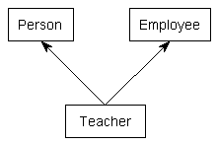
Going ahead with OOP in Java (not covered)
OOP concepts supported by Java:
Classes (and obviously, objects)
Interfaces – a special type of classes
Inheritance – but NOT multiple inheritance
Polymorphism:
method overloading
method overriding
Java does not support user-defined operator overloading.
ILLEGAL IN JAVA
Caveat: Interfaces can overcome this!
25/07/2019
Introduction to Java
<number>

Slide 15
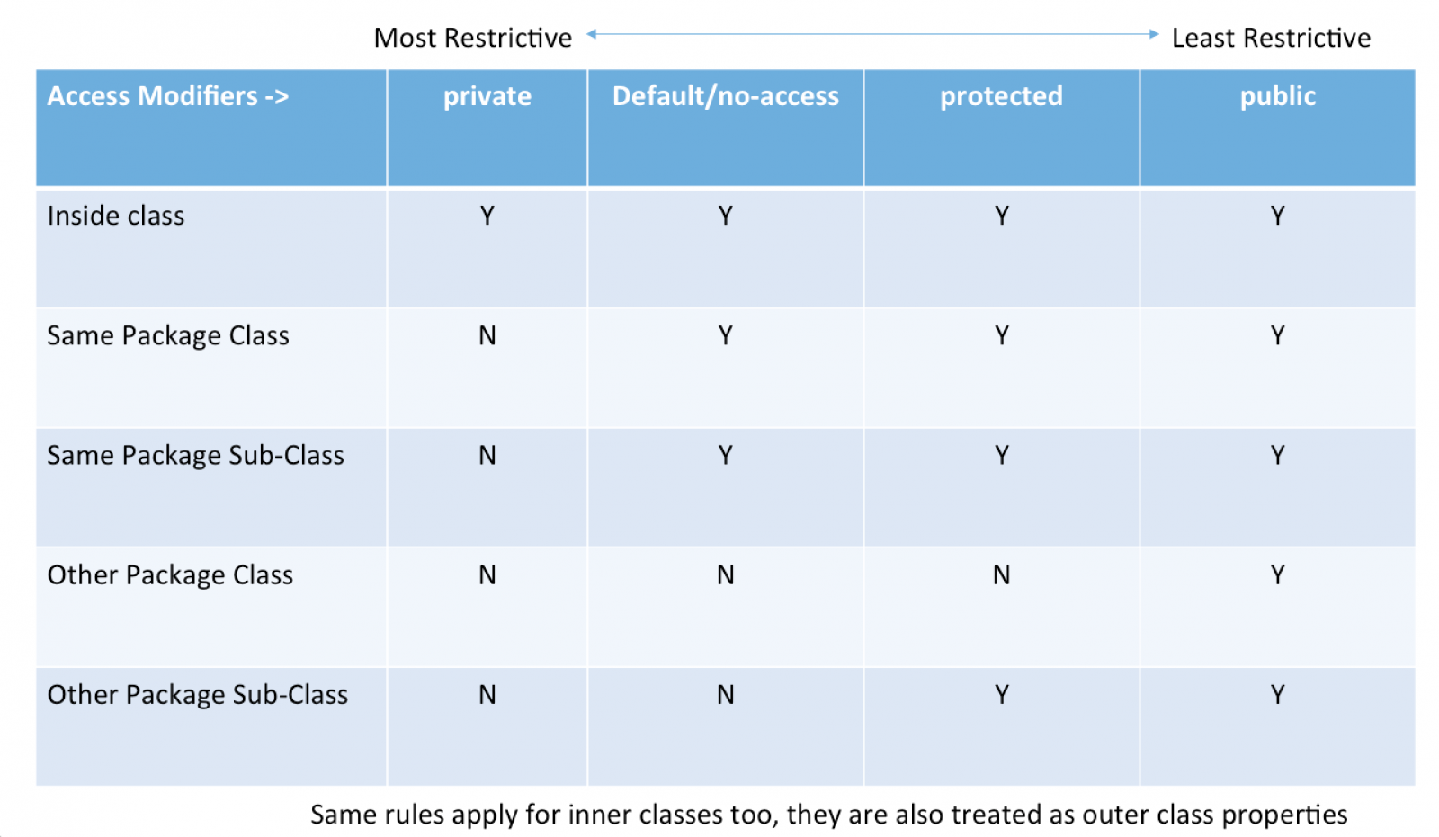
Going ahead with OOP in Java (not covered)
Concept of a package
Security:
private
public
protected
default
25/07/2019
Introduction to Java
<number>

Slide 16
Let’s create a class! (covered)
class TeaPot {
private static int numOfTeaPots = 0;
private String teaPotColor;
public TeaPot (String c) {
teaPotColor = c;
numOfTeaPots++;
}
public static int howManyTeaPots()
{ return numOfTeaPots; }
public String getColor()
{ return teaPotColor; }
}
public class MainClass {
public static void main (String[] args) {
TeaPot tp1 = new TeaPot (“Red”);
TeaPot tp2 = new TeaPot (“Green”);
System.out.println(tp1.getColor());
System.out.println(tp2.getColor());
int num = TeaPot.howManyTeaPots();
System.out.println(“No of teapots =”);
System.out.println(num);
}
}
25/07/2019
Introduction to Java
<number>

Slide 17
Let’s inherit! (not covered)
class Base { void printClassName() { System.out.println(“Base”); } } class Derived extends Base { void printClassName() { System.out.println(“Derived”); } } | public class MainClass { public static void main (String[] args) { Base b1 = new Base(); Derived d1 = new Derived(); Base b2 = new Derived(); b1.printClassName(); d1.printClassName(); b2.printClassName(); } }
Notice the overridden method.
25/07/2019
Introduction to Java
<number>

Slide 18
Polymorphism and the super keyword (not covered)
class Base { void printClassName() { System.out.println(“Base”); } void printClassName(int n) { System.out.println(“Base_” + n); } } class Derived extends Base { void printClassName() { System.out.println(“Derived”); } void printClassName(int n) { super.printClassName(n); } } | public class MainClass { public static void main (String[] args) { Base b1 = new Base(); Derived d1 = new Derived(); b1.printClassName(); b1.printClassName(1); d1.printClassName(); d1.printClassName(2); } }
25/07/2019
Introduction to Java
<number>

Slide 19
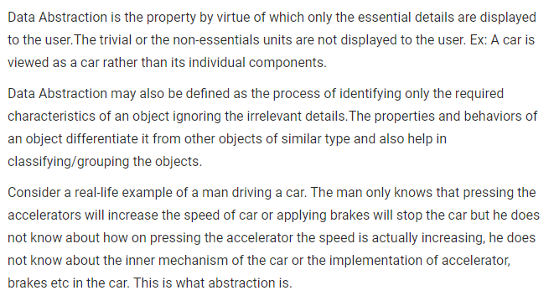
Food for thought: ABSTRACTION (not covered)
25/07/2019
Introduction to Java
<number>

